Slide 1

Chapter 7: Relational Database Design
中国大学MOOC“数据库系统概论”
https://www.icourse163.org/learn/XDU-1002199005

Slide 2
Chapter 7: Relational Database Design
Features of Good Relational Design
Atomic Domains and First Normal Form
Decomposition Using Functional Dependencies
Functional Dependency Theory
Algorithms for Functional Dependencies
Decomposition Using Multivalued Dependencies
More Normal Form
Database-Design Process
Modeling Temporal Data

Slide 3
Introduction
Normalization (规范化) is another approach to logical design of a relational database.
E-R approach and normalization approach reinforce each other.
Normalization starts with a real-world situation to be modeled and lists the data items that are candidates to become column names in relational tables, together with a list of rules about the relatedness of these data items.
The aim is to represent all these data items as attributes of tables that obey restrictive conditions associated with what we call normal forms (范式).
  1NF --> 2NF --> 3NF --> BCNF --> 4NF --> 5NF

Slide 4

Combine Schemas?
Suppose we combine instructor and department into inst_dept
  (No connection to relationship set inst_dept)
Result is possible repetition of information

Slide 5
A Combined Schema Without Repetition
Consider combining relations
  sec_class(sec_id, building, room_number) and
  section(course_id, sec_id, semester, year)
  into one relation
  section(course_id, sec_id, semester, year, building, room_number)
No repetition in this case

Slide 6
What About Smaller Schemas?
Suppose we had started with inst_dept. How would we know to split up (decompose) it into instructor and department?
Write a rule “if there were a schema (dept_name, building, budget), then dept_name would be a candidate key”
Denote as a functional dependency:
dept_name → building, budget
In inst_dept, because dept_name is not a candidate key, the building and budget of a department may have to be repeated.
  This indicates the need to decompose inst_dept

Slide 7
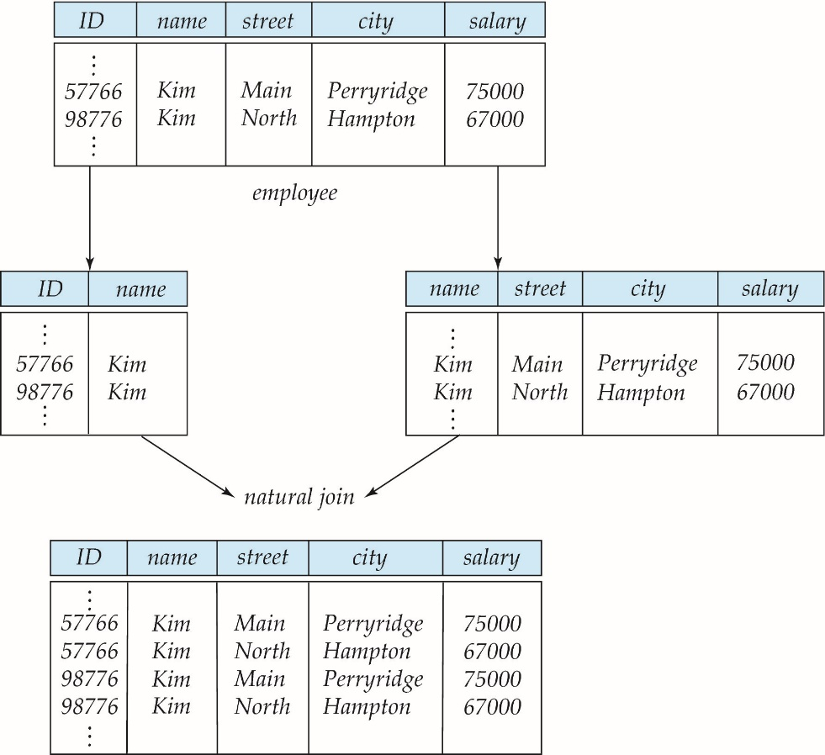
A Lossy Decomposition
Not all decompositions are good. Suppose we decompose
employee(ID, name, street, city, salary) into
employee1 (ID, name)， employee2 (name, street, city, salary)
we cannot reconstruct the original employee relation -- and so, this is a lossy decomposition.

Slide 8
Example of Lossless-Join Decomposition
Lossless join decomposition
Decomposition of R = (A, B, C)
R₁ = (A, B) R₂ = (B, C)
A
B
C
A
B
B
C
α
β
1
2
A
B
α
β
1
2
1
2
A
B
r
∏_{A,B}(r)
∏_{B,C}(r)
∏_{A} (r) ∏_{B} (r)
A
B
C
α
β
1
2
A
B

Slide 9
Normalization theory
Decide whether a particular relation R is in “good” or NOT?
Normalization theory is the tools used to solve those questions.

Slide 10
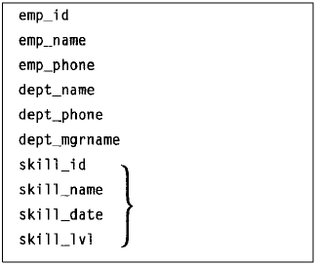
A Running Example
Employee Information:
From one up to a large number of skills useful to the company

Slide 11
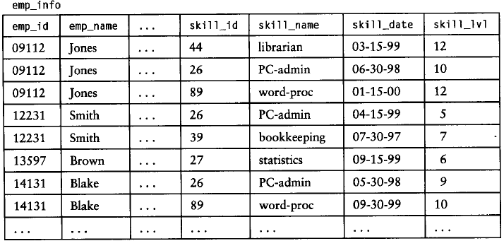
A Running Example
Employee Information:

Slide 12
Anomalies of a Bad Database Design
Update Anomaly (修改异常)
  A table T is subject to an update anomaly when changing a single attribute value for an entity instance or relationship instance represented in the table may require that several rows of T be updated.

Slide 13
Anomalies of a Bad Database Design
Delete Anomaly
  A table T is subject to a delete anomaly when deleting some row of the table to reflect the disappearance of some instance of an entity or relationship can cause us to lose information about some instance of a different entity or relationship that we do not wish to forget.

Slide 14
Anomalies of a Bad Database Design
Insert Anomaly
  We cannot represent information about some entity or instance without including information about some other instance of an entity or relationship that does not exist.

Slide 15
Anomalies of a Bad Database Design
Redundant Data （数据冗余）
  An entity instance or relationship instance represented in a table T may account for several rows of T.

Slide 16
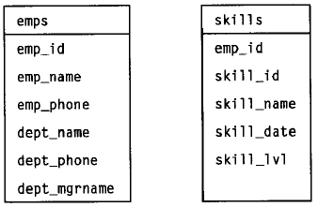
Anomalies of a Bad Database Design
Normalize the relation…
decompose

Slide 17
Goal — Devise a Theory for the Following
Decide whether a particular relation R is in “good” form.
In the case that a relation R is not in “good” form, decompose it into a set of relations {R₁, R₂, ..., R_{n}} such that
  each relation is in good form
  the decomposition is a lossless-join decomposition
Our theory is based on:
  functional dependencies
  multivalued dependencies

Slide 18
Functional Dependencies

Slide 19
Functional Dependencies (Cont.)
Let R be a relation schema
α ⊆ R and β ⊆ R
The functional dependency
α → β
holds on R if and only if for any legal relations r(R), whenever any two tuples t₁ and t₂ of r agree on the attributes α, they also agree on the attributes β. That is,
t₁[α] = t₂ [α] ⇒ t₁[β ] = t₂ [β ]
Example: Consider r(A,B ) with the following instance of r.
On this instance, A → B does NOT hold, but B → A does hold.
4
1 5
3 7

Slide 20
Functional Dependencies
emp_info table
emp_id → emp_name
emp_id → emp_phone?
emp_id → dep_name ?, and emp_phone emp_id

Slide 21
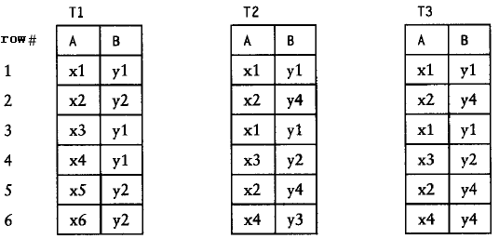

Functional Dependencies
Analyze the following tables (suppose they are valid)
T1: A → B
B A
T2: A → B
B → A
T3: A → B
B A

Slide 22
Functional Dependencies (Cont.)
K is a superkey for relation schema R if and only if K → R
K is a candidate key for R if and only if
  K → R, and
  for no α ⊂ K, α → R
Functional dependencies allow us to express constraints that cannot be expressed using superkeys. Consider the schema:
inst_dept (ID, name, salary, dept_name, building, budget ).
We expect these functional dependencies to hold:
dept_name→ building
and ID → building
but would not expect the following to hold:
dept_name → salary

Slide 23
Use of Functional Dependencies
We use functional dependencies to:
  test relations to see if they are legal under a given set of functional dependencies.
    If a relation r is legal under a set F of functional dependencies, we say that r satisfies F.
  specify constraints on the set of legal relations
    We say that F holds on R if all legal relations on R satisfy the set of functional dependencies F.
Note: A specific instance of a relation schema may satisfy a functional dependency even if the functional dependency does not hold on all legal instances.
  For example, a specific instance of instructor may, by chance, satisfy
  name → ID.

Slide 24
Functional Dependencies (Cont.)
A functional dependency is trivial if it is satisfied by all instances of a relation
  Example:
    ID, name → ID
    name → name
  In general, α → β is trivial if β ⊆ α

Slide 25
1NF

Slide 26
First Normal Form
Domain is atomic if its elements are considered to be indivisible units
  Examples of non-atomic domains:
    Set of names, composite attributes
    Identification numbers like CS101 that can be broken up into parts
A relational schema R is in first normal form if the domains of all attributes of R are atomic
Non-atomic values complicate storage and encourage redundant (repeated) storage of data
  Example: Set of accounts stored with each customer, and set of owners stored with each account
  We assume all relations are in first normal form (and revisit this in Chapter 22: Object Based Databases)

Slide 27
First Normal Form
Atomicity is actually a property of how the elements of the domain are used.
  Example: Strings would normally be considered indivisible
  Suppose that students are given roll numbers which are strings of the form CS0012 or EE1127
  If the first two characters are extracted to find the department, the domain of roll numbers is not atomic.
  Doing so is a bad idea: leads to encoding of information in application program rather than in the database.

Slide 28
First Normal Form
A schema R not in 1NF, then it’s NOT a relational schema.
A relation R is in 1NF is not ‘good’ enough.
  For relation:
  Employee( emp_id, emp_name, emp_phone, dept_name, dept_phone, dept_mgrname, skill_id, skill_name, skill_date, skill_lvl )
    Is in 1NF
    Has Insert Anomaly, Delete Anomaly, Update Anomaly and Data Redundancy .

Slide 29
2NF

Slide 30
Second Normal Form
Second normal form (2NF): A relation schema R with FD set F is said to be in 2NF, if for any functional dependency X→A implied by F that lies in R, where A is a single attribute that is not in X and is non-prime(非主属性,不在任何候选码中出现的属性), X is not a proper subset(真子集) of any key K of R.
  Or there are NO non-prime attributes dependent on Candidate Key partially in 2NF.
  (不存在非主属性对码的部分依赖)
Example：R(A, B,C,D), F = {AB → C, AC → BD}
  Candidate Key : AB, AC
  AB → D, AC→ D is FULL dependency
  R∈2NF

Slide 31
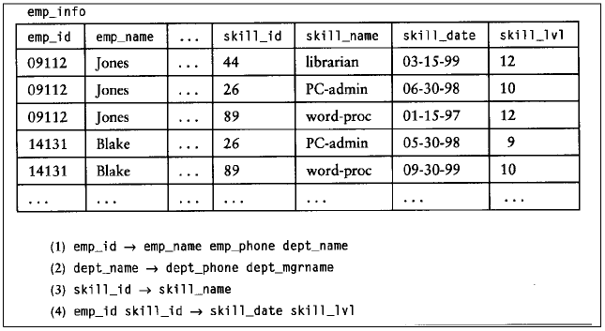
Second Normal Form
For example
  Is relation schema emp_info ∈2NF ?
    Candidate Key?
    Non-Prime attributes?
    Test all FD according the definition of Normal Form.
emp_info ∈2NF

Slide 32
Second Normal Form
  emp_info ( emp_id, emp_name, epm_phone, dept_name, dept_phone, dept_mgrname, skill_id, skill_name, skill_date, skill_lvl )
  F = { emp_id → emp_name, epm_phone, dept_name,
  dept_name → dept_phone, dept_mgrname,
  skill_id → skill_name,
  emp_id, skill_id → skill_date, skill_lvl }
  Decomposition(模式分解):
  emp (emp_id, emp_name, epm_phone, dept_name,
  dept_phone, dept_mgrname )
  skill ( skill_id, skill_name )
  emp_skill ( emp_id, skill_id, skill_date, skill_lvl )
∈2NF
∈2NF
∈2NF

Slide 33
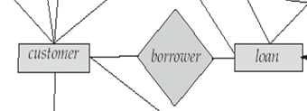
Second Normal Form
  For relation:
  bor_loan (customer_id, loan_number, amount )
  F = {loan_number → amount }
    CK: ( customer_id, loan_number )
    bor_loan is NOT in 2NF
    For borrower is M:N relationship
Merging a M:N relationship with an entity it associated induces a NON-2NF relation schema.

Slide 34
Second Normal Form
A relation R is in 2NF is not ‘good’ enough.
  For relation:
  emp (emp_id, emp_name, epm_phone, dept_name,
  dept_phone, dept_mgrname ) ∈2NF
    Has Insert Anomaly, Delete Anomaly, Update Anomaly and Data Redundancy .

Slide 35
BCNF

Slide 36
Boyce-Codd Normal Form
A relation schema R is in BCNF with respect to a set F of functional dependencies if for all functional dependencies in F⁺ of the form
α→ β
where α ⊆ R and β ⊆ R, at least one of the following holds:
α → β is trivial (i.e., β ⊆ α)
α is a superkey for R
Example schema not in BCNF:
instr_dept (ID, name, salary, dept_name, building, budget )
because dept_name→ building, budget
holds on instr_dept, but dept_name is not a superkey

Slide 37
Decomposing a Schema into BCNF
Suppose we have a schema R and a non-trivial dependency α→β causes a violation of BCNF.
We decompose R into:
  (αU β )
  ( R - ( β - α ) )
In our example,
  α = dept_name
  β = building, budget
  and inst_dept is replaced by
  (αU β ) = ( dept_name, building, budget )
  ( R - ( β - α ) ) = ( ID, name, salary, dept_name )

Slide 38
BCNF and Dependency Preservation
Constraints, including functional dependencies, are costly to check in practice unless they pertain to only one relation
If it is sufficient to test only those dependencies on each individual relation of a decomposition in order to ensure that all functional dependencies hold, then that decomposition is dependency preserving.

Slide 39
Goals of Normalization
Let R be a relation scheme with a set F of functional dependencies.
Decide whether a relation scheme R is in “good” form.
In the case that a relation scheme R is not in “good” form, decompose it into a set of relation scheme {R₁, R₂, ..., R_{n}} such that
  each relation scheme is in good form
  the decomposition is a lossless-join decomposition
  Preferably, the decomposition should be dependency preserving.

Slide 40
How good is BCNF?
There are database schemas in BCNF that do not seem to be sufficiently normalized
Consider a relation
inst_info (ID, child_name, phone)
  where an instructor may have more than one phone and can have multiple children
ID
child_name
phone
99999
99999
99999
99999
David
David
William
Willian
512-555-1234
512-555-4321
512-555-1234
512-555-4321

Slide 41
How good is BCNF? (Cont.)
There are no non-trivial functional dependencies and therefore the relation is in BCNF
Insertion anomalies – i.e., if we add a phone 981-992-3443 to 99999, we need to add two tuples
(99999, David, 981-992-3443)
(99999, William, 981-992-3443)

Slide 42
How good is BCNF? (Cont.)
Therefore, it is better to decompose inst_info into:
ID
child_name
inst_child
99999
99999
99999
99999
David
David
William
Willian
ID
phone
inst_phone
99999
99999
99999
99999
512-555-1234
512-555-4321
512-555-1234
512-555-4321
This suggests the need for higher normal forms, such as Fourth Normal Form (4NF), which we shall see later.

Slide 43
Closure

Slide 44
Closure of a Set of Functional Dependencies
Given a set F of functional dependencies, there are certain other functional dependencies that are logically implied by F.
  For example: If A → B and B → C, then we can infer that A → C
The set of all functional dependencies logically implied by F is the closure of F.
We denote the closure of F by F⁺.
F⁺ is a superset of F.

Slide 45
Closure of a Set of Functional Dependencies
We can find F^{+,} the closure of F, by repeatedly applying
Armstrong’s Axioms:
  if Y ⊆ X, then X → Y (reflexivity)
  if X → Y, and Y → Z, then X → Z (transitivity)
  if X → Y, then XZ → YZ (augmentation)
These rules are
  sound (generate only functional dependencies that actually hold), and
  complete (generate all functional dependencies that hold).

Slide 46
Armstrong’s Axioms
Armstrong’s Axiom (阿姆斯特朗公理 1974)
  A1: Inclusion rule(包含规则): if Y ⊆ X, then X→Y
  证明：对于关系模式R<U,F>的任一关系r中的任意两个元组t和s，若t[X]=s[X]，由于Y ⊆X，则t[Y]=s[Y]，故X→Y。
  Example:
    customer_name, loan_number → customer_name
    customer_name → customer_name

Slide 47
Armstrong’s Axioms
Armstrong’s Axiom (阿姆斯特朗公理 1974)
  A2: Transitivity rule(传递规则): if X → Y and Y → Z , then X → Z
  证明：对于关系模式R<U，F> 的任一关系 r中的任意两个元组 t和s，若t[X]=s[X]，由于X→Y，有 t[Y]=s[Y]；再由Y→Z，有t[Z]=s[Z]，所以F ╞ X→Z。
  Example:
    For relation: S( sno, sname, sdept, dept_manager )
    sno → sdept, sdept → dept_manager
    THEN: sno → dept_manager

Slide 48
Armstrong’s Axioms
Armstrong’s Axiom (阿姆斯特朗公理 1974)
  A3: Augmentation rule(增广规则): if X → Y, then XZ → YZ
  证明：对于关系模式R<U,F>的任一关系r中的任意两个元组t和s，若t[XZ]=s[XZ]；则有t[X]=s[X]和t[Z]=s[Z]；由X→Y，则有t[Y]=s[Y]；所以t[YZ]=s[YZ]，故F╞XZ→YZ。
  Example:
    For relation: S( sno, sname, sdept, dept_manager )
    sno → sdept
    THEN: (sno , sname) → sdept, sname

Slide 49
Example
R = (A, B, C, G, H, I)
F = { A → B
A → C
CG → H
CG → I
B → H}
some members of F⁺
  A → H
    by transitivity from A → B and B → H
  AG → I
    by augmenting A → C with G, to get AG → CG
    and then transitivity with CG → I
  CG → HI
    by augmenting CG → I to infer CG → CGI,
    and augmenting of CG → H to infer CGI → HI,
    and then transitivity

Slide 50
Procedure for Computing F⁺
To compute the closure of a set of functional dependencies F:
F ⁺ = F
repeat
for each functional dependency f in F⁺
apply reflexivity and augmentation rules on f
add the resulting functional dependencies to F ⁺
for each pair of functional dependencies f₁and f₂ in F ⁺
if f₁ and f₂ can be combined using transitivity
then add the resulting functional dependency to F ⁺
until F ⁺ does not change any further
NOTE: We shall see an alternative procedure for this task later

Slide 51
Closure of Functional Dependencies (Cont.)
Additional rules:
  If X → Y holds and X → Z holds, then X → YZ holds (union)
  If X → YZ holds, then X → Y holds and X → Z holds (decomposition)
  If X → Y holds and WY → Z holds, then XW → Z holds (pseudotransitivity)
  If X →YZ holds and Z →W holds, then X→ YZW holds (Set accumulation)
  The above rules can be inferred from Armstrong’s axioms.

Slide 52
Implications of Armstrong’s Axioms
  [1] Union rule(合并规则): if X → Y and X →Z, then X → YZ
    证明： (1) X→Y 已知(P规则)
    (2) X→XY A2，(1)
    (3) X→Z 已知
    (4) XY→YZ A2，(3)
    (5) X→YZ A3，(2)，(4)
    ∴ {X→Y，X→Z } ╞ X→YZ
  Example: S( sno, sname, sdept, dept_manager )
    sno → sname , sno → sdept
    THEN: sno → sname , sdept

Slide 53
Implications of Armstrong’s Axioms
  [2] Decomposition rule(分解规则): if X → YZ, then X → Y and X → Z
    Example: S( sno, sname, sdept, dept_manager )
      sno → sname , sdept
      THEN: sno → sname , sno → sdept
  [3] Pseudotransitivity rule(伪传递规则): if X → Y and WY →Z, then XW → Z
  [4] Set accumulation rule(集合累积规则): if X →YZ and Z →W, then X→ YZW
  (证明方法略)

Slide 54
Closure of Attribute Sets (属性集的闭包)
Given a set of attributes α, define the closure of α under F (denoted by α⁺) as the set of attributes that are functionally determined by α under F
Algorithm to compute α⁺, the closure of α under F
result := α;
while (changes to result) do
for each β → γ in F do
begin
if β ⊆ result then result := result ∪ γ
end

Slide 55
Example of Attribute Set Closure
R = (A, B, C, G, H, I)
F = {A → B
A → C
CG → H
CG → I
B → H}
求(AG)⁺
  1. result = AG
  2. result = ABCG (A → C and A → B)
  3. result = ABCGH (CG → H and CG ⊆ AGBC)
  4. result = ABCGHI (CG → I and CG ⊆ AGBCH)
Is AG a candidate key?
  Is AG a super key?
    Does AG → R? == Is (AG)⁺ ⊇ R
  Is any subset of AG a superkey?
    Does A → R? == Is (A)⁺ ⊇ R
    Does G → R? == Is (G)⁺ ⊇ R

Slide 56
Closure
Closure of attributes (属性集的闭包)
There are several uses of the attribute closure algorithm:
  1) Testing for superkey:
  To test if α is a superkey, we compute α^{+,} and check if α⁺ contains all attributes of R.
  Example: for relation R<U, F>, U = {A, B, C, D, E},
  F = {AB→C, B→D, C→E, EC→B, AC→B }
  IS AB a superkey or not?
    (AB)_{F}⁺＝{ABCDE} = U
    So AB is a superkey

Slide 57

Closure
Closure of attributes (属性集的闭包)
There are several uses of the attribute closure algorithm:
  2) Testing functional dependencies
    To check if a functional dependency α → β holds (or, in other words, is in F⁺), just check if β ⊆ α⁺.
    Example: for relation R<U, F>, U = {A, B, C, D, E},
    F = {AB→C, B→D, C→E, EC→B, AC→B }
      IS BE→CD implied by F?
      For (BE)_{F}⁺＝{BED} , not include CD, so not implied.
      IS AB→E implied by F?
    (Theorem) :

Slide 58

Closure
Closure of attributes (属性集的闭包)
There are several uses of the attribute closure algorithm:
  3) Computing closure of F
    For each γ ⊆ R, we find the closure γ⁺, and for each S ⊆ γ⁺, we output a functional dependency γ → S.
    (Theorem) :

Slide 59
Cover

Slide 60
Cover
FD Set Cover(函数依赖集的覆盖):
  A set F of FDs on a table T is said to cover another set G of FDs on T, if the set G of FDs can be derived by implication rules from the set F, or in other words. If G⊆F⁺.
  If F covers G and G covers F, then the two sets of FDs are said to be equivalent, and we write F≡ G.
  If two FDs are equivalent, they have the same implication of FDs.
  Example:
    Consider the two sets of FDs on relaton R(ABCDE) :
    F={B→CD, AD→E, B→A} and
    G={B→CDE, B→ABC, AD→E}
    Is F≡ G or NOT?

Slide 61
Cover
Sets of functional dependencies may have redundant dependencies that can be inferred from the others
  For example: A → C is redundant in: {A → B, B → C, A → C}
  Parts of a functional dependency may be redundant
    E.g.: on RHS: {A → B, B → C, A → CD} can be simplified to
    {A → B, B → C, A → D}
    E.g.: on LHS: {A → B, B → C, AC → D} can be simplified to
    {A → B, B → C, A → D}

Slide 62
Extraneous Attributes
Consider a set F of functional dependencies and the functional dependency α → β in F.
  Attribute A is extraneous in α if A ∈ α
  and F logically implies (F – {α → β}) ∪ {(α – A) → β}.
  Attribute A is extraneous in β if A ∈ β
  and the set of functional dependencies
  (F – {α → β}) ∪ {α →(β – A)} logically implies F.

Slide 63
Testing if an Attribute is Extraneous
Consider a set F of functional dependencies and the functional dependency α → β in F.
To test if attribute A ∈ α is extraneous in α
  compute ({α} – A)⁺ using the dependencies in F
  check that ({α} – A)⁺ contains β; if it does, A is extraneous in α
To test if attribute A ∈ β is extraneous in β
  compute α⁺ using only the dependencies in
  F’ = (F – {α → β}) ∪ {α →(β – A)},
  check that α⁺ contains A; if it does, A is extraneous in β

Slide 64
Minimal Cover
Minimal Cover(最小覆盖，最小函数依赖集)
  Step 1. Decomposition Right Hand Side of FDs
  Create an equivalent set H of FDs, with only single attributes on the right side.(等价变换)
  Step 2. Erase extraneous attributes on LHS
  For α → β in F Attribute A is extraneous in α if A ∈ α
  and F logically implies (F – {α → β}) ∪ {(α – A) → β}. Then replace α → β with (α – A) → β
  Step 3. Delete redundant FD
  For α → β in F, if (F – {α → β}) logically implies α → β, then delete α → β from F.

Slide 65
Minimal Cover
Example: for relation R<U, F>, U = {A, B, C, D, E}, F={A→BC, BCD→E, B→D, A→D, E→A}
compute the minimal cover of F.
  1) 右部化为单一属性
  F₁={A→B, A→C, BCD→E, B→D, A→D, E→A}
  2) 去掉左部冗余属性
  for (BC)_{F}⁺=BCDEA, include E, so D in LHS of BCD→E is extraneous.
  F₂＝{A→B, A→C, BC→E, B→D, A→D, E→A}
  3) 去掉多余函数依赖
  for A→D because of (A)⁺ _{F2-(A→D )}=ABCED, is redundancy
  F_{min} = {A→B, A→C, BC→E, B→D, E→A}

Slide 66
Canonical Cover
A canonical cover for F is a set of dependencies F_{c} such that
  F logically implies all dependencies in F_{c,} and
  F_{c} logically implies all dependencies in F, and
  No functional dependency in F_{c} contains an extraneous attribute, and
  Each left side of functional dependency in F_{c} is unique.

Slide 67
Canonical Cover
To compute a canonical cover for F:
repeat
Use the union rule to replace any dependencies in F
α₁ → β₁ and α₁ → β₂ with α₁ → β₁ β₂
Find a functional dependency α → β with an
extraneous attribute either in α or in β
/* Note: test for extraneous attributes done using F_{c,} not F*/
If an extraneous attribute is found, delete it from α → β
until F does not change
Note: Union rule may become applicable after some extraneous attributes have been deleted, so it has to be re-applied
gather all FDs in Minimal Cover with equal left-hand sides and use the union rule to create an equivalent set of FDs where all left-hand sides are unique, we’ll get canonical cover .

Slide 68
Computing a Canonical Cover
R = (A, B, C)
F = {A → BC
B → C
A → B
AB → C}
Combine A → BC and A → B into A → BC
  Set is now {A → BC, B → C, AB → C}
A is extraneous in AB → C
  Check if the result of deleting A from AB → C is implied by the other dependencies
    Yes: in fact, B → C is already present!
  Set is now {A → BC, B → C}
C is extraneous in A → BC
  Check if A → C is logically implied by A → B and the other dependencies
    Yes: using transitivity on A → B and B → C.
      Can use attribute closure of A in more complex cases
The canonical cover is: A → B
B → C

Slide 69
Functional-Dependency Theory
We now consider the formal theory that tells us which functional dependencies are implied logically by a given set of functional dependencies.
We then develop algorithms to generate lossless decompositions into BCNF and 3NF
We then develop algorithms to test if a decomposition is dependency-preserving

Slide 70
Lossless-join Decomposition
For the case of R = (R₁, R₂), we require that for all possible relations r on schema R
r = ∏_{R1} (r ) ∏_{R2} (r )
A decomposition of R into R₁ and R₂ is lossless join if at least one of the following dependencies is in F⁺:
  R₁ ∩ R₂ → R₁
  R₁ ∩ R₂ → R₂
The above functional dependencies are a sufficient condition for lossless join decomposition; the dependencies are a necessary condition only if all constraints are functional dependencies

Slide 71
Dependency Preservation
Let F_{i} be the set of dependencies F ⁺ that include only attributes in R_{i}.
    A decomposition is dependency preserving, if
    (F₁ ∪ F₂ ∪ … ∪ F_{n} )⁺ = F ⁺
    If it is not, then checking updates for violation of functional dependencies may require computing joins, which is expensive.

Slide 72
Testing for Dependency Preservation
To check if a dependency α → β is preserved in a decomposition of R into R₁, R₂, …, R_{n} we apply the following test (with attribute closure done with respect to F)
  result = α
  while (changes to result) do
  for each R_{i} in the decomposition
  t = (result ∩ R_{i})⁺ ∩ R_{i}
  result = result ∪ t
  If result contains all attributes in β, then the functional dependency
  α → β is preserved.
We apply the test on all dependencies in F to check if a decomposition is dependency preserving
This procedure takes polynomial time, instead of the exponential time required to compute F⁺ and (F₁ ∪ F₂ ∪ … ∪ F_{n})⁺

Slide 73
Example
R = (A, B, C)
F = {A → B, B → C)
  Can be decomposed in two different ways
R₁ = (A, B), R₂ = (B, C)
  Lossless-join decomposition:
  R₁ ∩ R₂ = {B} and B → BC
  Dependency preserving
R₁ = (A, B), R₂ = (A, C)
  Lossless-join decomposition:
  R₁ ∩ R₂ = {A} and A → AB
  Not dependency preserving
  (cannot check B → C without computing R₁ R₂)

Slide 74
BCNF Decomposition

Slide 75
Testing for BCNF
To check if a non-trivial dependency α→β causes a violation of BCNF
  1. compute α⁺ (the attribute closure of α), and
  2. verify that it includes all attributes of R, that is, it is a superkey of R.
Simplified test: To check if a relation schema R is in BCNF, it suffices to check only the dependencies in the given set F for violation of BCNF, rather than checking all dependencies in F⁺.
  If none of the dependencies in F causes a violation of BCNF, then none of the dependencies in F⁺ will cause a violation of BCNF either.

Slide 76
Testing Decomposition for BCNF
To check if a relation R_{i} in a decomposition of R is in BCNF,
  Either test R_{i} for BCNF with respect to the restriction of F to R_{i} (that is, all FDs in F⁺ that contain only attributes from R_{i})
  or use the original set of dependencies F that hold on R, but with the following test:
      for every set of attributes α ⊆ R_{i}, check that α⁺ (the attribute closure of α) either includes no attribute of R_{i}- α, or includes all attributes of R_{i}.
    If the condition is violated by some α→ β in F, the dependency
    α→ (α⁺ - α) ∩ R_{i}
    can be shown to hold on R_{i}, and R_{i} violates BCNF.
    We use above dependency to decompose R_{i}

Slide 77
BCNF Decomposition Algorithm
result := {R };
done := false;
compute F ⁺;
while (not done) do
if (there is a schema R_{i} in result that is not in BCNF)
then begin
let α → β be a nontrivial functional dependency that
holds on R_{i} such that α→ R_{i} is not in F ⁺,
and α ∩ β = ∅;
result := (result – R_{i} ) ∪ (R_{i} – β) ∪ (α, β );
end
else done := true;
Note: each R_{i} is in BCNF, and decomposition is lossless-join.

Slide 78
Example of BCNF Decomposition
R = (A, B, C )
F = {A → B
B → C}
Key = {A}
R is not in BCNF (B → C but B is not superkey)
Decomposition
  R₁ = (B, C)
  R₂ = (A,B)

Slide 79
Example of BCNF Decomposition
class (course_id, title, dept_name, credits, sec_id, semester, year, building, room_number, capacity, time_slot_id)
Functional dependencies:
  course_id→ title, dept_name, credits
  building, room_number→capacity
  course_id, sec_id, semester, year→building, room_number, time_slot_id
Candidate key {course_id, sec_id, semester, year}.
BCNF Decomposition:
  course_id→ title, dept_name, credits holds
    but course_id is not a superkey.
  We replace class by:
    course(course_id, title, dept_name, credits)
    class-1 (course_id, sec_id, semester, year, building,
    room_number, capacity, time_slot_id)

Slide 80
BCNF Decomposition (Cont.)
building, room_number→capacity holds on class-1
  but {building, room_number} is not a superkey for class-1.
  We replace class-1 by:
    classroom (building, room_number, capacity)
    section (course_id, sec_id, semester, year, building, room_number, time_slot_id)
classroom and section are in BCNF.

Slide 81
BCNF and Dependency Preservation
It is not always possible to get a BCNF decomposition that is
dependency preserving
R = (J, K, L )
F = {JK → L
L → K }
Two candidate keys = JK and JL
R is not in BCNF
Any decomposition of R will fail to preserve
JK → L
This implies that testing for JK → L requires a join

Slide 82
3NF

Slide 83
Third Normal Form: Motivation
There are some situations where
  BCNF is not dependency preserving, and
  efficient checking for FD violation on updates is important
Solution: define a weaker normal form, called Third Normal Form (3NF)
  Allows some redundancy (with resultant problems; we will see examples later)
  There is always a lossless-join, dependency-preserving decomposition into 3NF.

Slide 84
Third Normal Form
A relation schema R is in third normal form (3NF) if for all:
α → β in F⁺
at least one of the following holds:
  α → β is trivial (i.e., β ∈ α)
  α is a superkey for R
  Each attribute A in β – α is contained in a candidate key for R.
  (NOTE: each attribute may be in a different candidate key)
If a relation is in BCNF it is in 3NF (since in BCNF one of the first two conditions above must hold).
Third condition is a minimal relaxation of BCNF to ensure dependency preservation (will see why later).

Slide 85
3NF Example
Relation dept_advisor:
  dept_advisor (s_ID, i_ID, dept_name)
  F = {s_ID, dept_name → i_ID, i_ID → dept_name}
  Two candidate keys: s_ID, dept_name, and i_ID, s_ID
  R is in 3NF
    s_ID, dept_name → i_ID s_ID
      dept_name is a superkey
    i_ID → dept_name
      dept_name is contained in a candidate key

Slide 86
Third Normal Form
Another define: A relation R is in 3NF if there are no nonprime attributes which transitively dependent on a key for R.
(3NF 中不存在非主属性对码的传递依赖)
For example
loan_b (loan_number, branch_name, branch_city, assets)
  F = {loan_number → branch_name ,
  branch_name → branch_city, assets }
  loan_number → branch_name,
  branch_name → branch_city
  so nonprime attribute branch_city is transitively dependent on candidate key loan_number
  It is NOT in 3NF
  The two definitions are equivalent.

Slide 87
Redundancy in 3NF
There is some redundancy in this schema
Example of problems due to redundancy in 3NF
  R = (J, K, L)
  F = {JK → L, L → K }
J
L
K
j₁
j₂
j₃
null
l₁
l₁
l₁
l₂
k₁
k₁
k₁
k₂
repetition of information (e.g., the relationship l₁, k₁)
  (i_ID, dept_name)
need to use null values (e.g., to represent the relationship
l₂, k₂ where there is no corresponding value for J).
  (i_ID, dept_nameI) if there is no separate relation mapping instructors to departments

Slide 88
Testing for 3NF
Optimization: Need to check only FDs in F, need not check all FDs in F⁺.
Use attribute closure to check for each dependency α → β, if α is a superkey.
If α is not a superkey, we have to verify if each attribute in β is contained in a candidate key of R

Slide 89
3NF Decomposition Algorithm
Let F_{c} be a canonical cover for F;
i := 0;
for each functional dependency α → β in F_{c} do
if none of the schemas R_{j}, 1 ≤ j ≤ i contains α β
then begin
i := i + 1;
R_{i} := α β
end
if none of the schemas R_{j}, 1 ≤ j ≤ i contains a candidate key for R
then begin
i := i + 1;
R_{i} := any candidate key for R;
end
/* Optionally, remove redundant relations */
repeat
if any schema R_{j} is contained in another schema R_{k}
then /* delete R_{j} */
R_{j} = R;;
i=i-1;
return (R₁, R₂, ..., R_{i})

Slide 90
3NF Decomposition: An Example
Relation schema:
  cust_banker_branch = (customer_id, employee_id, branch_name, type )
The functional dependencies for this relation schema are:
  customer_id, employee_id → branch_name, type
  employee_id → branch_name
  customer_id, branch_name → employee_id
We first compute a canonical cover
  branch_name is extraneous in the r.h.s. of the 1st dependency
  No other attribute is extraneous, so we get F_{C} =
  customer_id, employee_id → type
  employee_id → branch_name
  customer_id, branch_name → employee_id

Slide 91
3NF Decompsition Example (Cont.)
The for loop generates following 3NF schema:
(customer_id, employee_id, type )
(employee_id, branch_name)
(customer_id, branch_name, employee_id)
  Observe that (customer_id, employee_id, type ) contains a candidate key of the original schema, so no further relation schema needs be added
At end of for loop, detect and delete schemas, such as (employee_id, branch_name), which are subsets of other schemas
  result will not depend on the order in which FDs are considered
The resultant simplified 3NF schema is:
(customer_id, employee_id, type)
(customer_id, branch_name, employee_id)

Slide 92
Comparison of BCNF and 3NF
It is always possible to decompose a relation into a set of relations that are in 3NF such that:
  the decomposition is lossless
  the dependencies are preserved
It is always possible to decompose a relation into a set of relations that are in BCNF such that:
  the decomposition is lossless
  it may not be possible to preserve dependencies.

Slide 93
Design Goals
Goal for a relational database design is:
  BCNF.
  Lossless join.
  Dependency preservation.
If we cannot achieve this, we accept one of
  Lack of dependency preservation
  Redundancy due to use of 3NF

Slide 94
4NF

Slide 95
Multivalued Dependencies
Suppose we record names of children, and phone numbers for instructors:
  inst_child(ID, child_name)
  inst_phone(ID, phone_number)
If we were to combine these schemas to get
  inst_info(ID, child_name, phone_number)
  Example data:
  (99999, David, 512-555-1234)
  (99999, David, 512-555-4321)
  (99999, William, 512-555-1234)
  (99999, William, 512-555-4321)
This relation is in BCNF, but…

Slide 96
Multivalued Dependencies
It is better to decompose inst_info into:
ID
child_name
inst_child
99999
99999
99999
99999
David
David
William
Willian
ID
phone
inst_phone
99999
99999
99999
99999
512-555-1234
512-555-4321
512-555-1234
512-555-4321
This suggests the need for higher normal forms, such as Fourth Normal Form (4NF).

Slide 97
Multivalued Dependencies (MVDs)
Let R be a relation schema and let α ⊆ R and β ⊆ R. The multivalued dependency
α →→ β
holds on R if in any legal relation r(R), for all pairs for tuples t₁ and t₂ in r such that t₁[α] = t₂ [α], there exist tuples t₃ and t₄ in r such that:
t₁[α] = t₂ [α] = t₃ [α] = t₄ [α]
t₃[β] = t₁ [β]
t₃[R - β] = t₂[R - β]
t₄ [β] = t₂[β]
t₄[R - β] = t₁[R - β]
α | β | R-α- β
x | y₁ | z₁
x | y₂ | z₂
x | y₁ | z₂
x | y₂ | z₁
t₁
t₂
t₃
t₄

Slide 98
Example
Let R be a relation schema with a set of attributes that are partitioned into 3 nonempty subsets.
Y, Z, W
We say that Y →→ Z (Y multidetermines Z )
if and only if for all possible relations r (R )
< y₁, z₁, w₁ > ∈ r and < y₁, z₂, w₂ > ∈ r
then
< y₁, z₁, w₂ > ∈ r and < y₁, z₂, w₁ > ∈ r
Note that since the behavior of Z and W are identical it follows that
Y →→ Z if Y →→ W

Slide 99
Example (Cont.)
In our example:
ID →→ child_name
ID →→ phone_number
The above formal definition is supposed to formalize the notion that given a particular value of Y (ID) it has associated with it a set of values of Z (child_name) and a set of values of W (phone_number), and these two sets are in some sense independent of each other.

Slide 100
Use of Multivalued Dependencies
We use multivalued dependencies in two ways:
  1. To test relations to determine whether they are legal under a given set of functional and multivalued dependencies
  2. To specify constraints on the set of legal relations. We shall thus concern ourselves only with relations that satisfy a given set of functional and multivalued dependencies.
If a relation r fails to satisfy a given multivalued dependency, we can construct a relations r′ that does satisfy the multivalued dependency by adding tuples to r.

Slide 101
Theory of MVDs
From the definition of multivalued dependency, we can derive the following rule:
  If α → β, then α →→ β
That is, every functional dependency is also a multivalued dependency
The closure D⁺ of D is the set of all functional and multivalued dependencies logically implied by D.
  We can compute D⁺ from D, using the formal definitions of functional dependencies and multivalued dependencies.

Slide 102
Fourth Normal Form
A relation schema R is in 4NF with respect to a set D of functional and multivalued dependencies if for all multivalued dependencies in D⁺ of the form α →→ β, where α ⊆ R and β ⊆ R, at least one of the following hold:
  α →→ β is trivial (i.e., β ⊆ α or α ∪ β = R)
  α is a superkey for schema R
If a relation is in 4NF it is in BCNF

Slide 103
Restriction of Multivalued Dependencies
The restriction of D to R_{i} is the set D_{i} consisting of
  All functional dependencies in D⁺ that include only attributes of R_{i}
  All multivalued dependencies of the form
    α →→ (β ∩ R_{i})
  where α ⊆ R_{i} and α →→ β is in D⁺

Slide 104
4NF Decomposition Algorithm
result: = {R};
done := false;
compute D⁺;
Let D_{i} denote the restriction of D⁺ to R_{i}
while (not done)
if (there is a schema R_{i} in result that is not in 4NF) then
begin
let α →→ β be a nontrivial multivalued dependency that holds
on R_{i} such that α → R_{i} is not in D_{i}, and α∩β=φ;
result := (result - R_{i}) ∪ (R_{i} - β) ∪ (α, β);
end
else done:= true;
Note: each R_{i} is in 4NF, and decomposition is lossless-join

Slide 105
Example
R =(A, B, C, G, H, I)
F ={ A →→ B
B →→ HI
CG →→ H }
R is not in 4NF since A →→ B and A is not a superkey for R
Decomposition
a) R₁ = (A, B) (R₁ is in 4NF)
b) R₂ = (A, C, G, H, I) (R₂ is not in 4NF, decompose into R₃ and R₄)
c) R₃ = (C, G, H) (R₃ is in 4NF)
d) R₄ = (A, C, G, I) (R₄ is not in 4NF, decompose into R₅ and R₆)
  A →→ B and B →→ HI ➔ A →→ HI, (MVD transitivity), and
  and hence A →→ I (MVD restriction to R₄)
e) R₅ = (A, I) (R₅ is in 4NF)
f)R₆ = (A, C, G) (R₆ is in 4NF)

Slide 106
Database Design Process

Slide 107
Overall Database Design Process
We have assumed schema R is given
  R could have been generated when converting E-R diagram to a set of tables.
  R could have been a single relation containing all attributes that are of interest (called universal relation).
  Normalization breaks R into smaller relations.
  R could have been the result of some ad hoc design of relations, which we then test/convert to normal form.

Slide 108
ER Model and Normalization
When an E-R diagram is carefully designed, identifying all entities correctly, the tables generated from the E-R diagram should not need further normalization.
However, in a real (imperfect) design, there can be functional dependencies from non-key attributes of an entity to other attributes of the entity
  Example: an employee entity with attributes
  department_name and building,
  and a functional dependency
  department_name→ building
  Good design would have made department an entity
Functional dependencies from non-key attributes of a relationship set possible, but rare --- most relationships are binary

Slide 109
Denormalization for Performance
May want to use non-normalized schema for performance
For example, displaying prereqs along with course_id, and title requires join of course with prereq
Alternative 1: Use denormalized relation containing attributes of course as well as prereq with all above attributes
  faster lookup
  extra space and extra execution time for updates
  extra coding work for programmer and possibility of error in extra code
Alternative 2: use a materialized view defined as
course prereq
  Benefits and drawbacks same as above, except no extra coding work for programmer and avoids possible errors

Slide 110
Other Design Issues
Some aspects of database design are not caught by normalization
Examples of bad database design, to be avoided:
Instead of earnings (company_id, year, amount ), use
  earnings_2004, earnings_2005, earnings_2006, etc., all on the schema (company_id, earnings).
    Above are in BCNF, but make querying across years difficult and needs new table each year
  company_year (company_id, earnings_2004, earnings_2005,
  earnings_2006)
    Also in BCNF, but also makes querying across years difficult and requires new attribute each year.
    Is an example of a crosstab, where values for one attribute become column names
    Used in spreadsheets, and in data analysis tools

Slide 111
Modeling Temporal Data
Temporal data have an association time interval during which the data are valid.
A snapshot is the value of the data at a particular point in time
Several proposals to extend ER model by adding valid time to
  attributes, e.g., address of an instructor at different points in time
  entities, e.g., time duration when a student entity exists
  relationships, e.g., time during which an instructor was associated with a student as an advisor.
But no accepted standard
Adding a temporal component results in functional dependencies like
ID → street, city
not to hold, because the address varies over time
A temporal functional dependency X → Y holds on schema R if the functional dependency X → Y holds on all snapshots for all legal instances r (R).
⧫

Slide 112
Modeling Temporal Data (Cont.)
In practice, database designers may add start and end time attributes to relations
  E.g., course(course_id, course_title) is replaced by
    course(course_id, course_title, start, end)
    Constraint: no two tuples can have overlapping valid times
      Hard to enforce efficiently
Foreign key references may be to current version of data, or to data at a point in time
  E.g., student transcript should refer to course information at the time the course was taken

Slide 113
作业5
R = (A, B, C, D, E, F)
  F = {A → BC, E → CF, B → E, CD → EF}
  (AB)⁺ = ?
  (AD) ⁺ = ? Is AD →F implied by F?
Page 368
  8.6
  8.7

Slide 114
End of Chapter 7

